Slide 1

Corona virus analysis
Presenting by
Sudeep s​

Slide 2

Corona Virus Analysis
Overview:
The CORONA VIRUS pandemic has had a significant impact on public health and has created an urgent
need for data-driven insights to understand the spread of the virus. As a data analyst, you have been
tasked with analyzing a CORONA VIRUS dataset to derive meaningful insights and present your findings.

Slide 3
Dataset:
Description of each column in dataset:
Province: Geographic subdivision within a country/region.
Country/Region: Geographic entity where data is recorded.
Latitude: North-south position on Earth's surface.
Longitude: East-west position on Earth's surface.
Date: Recorded date of CORONA VIRUS data.
Confirmed: Number of diagnosed CORONA VIRUS cases.
Deaths: Number of CORONA VIRUS related deaths.
Recovered: Number of recovered CORONA VIRUS cases.

Slide 4
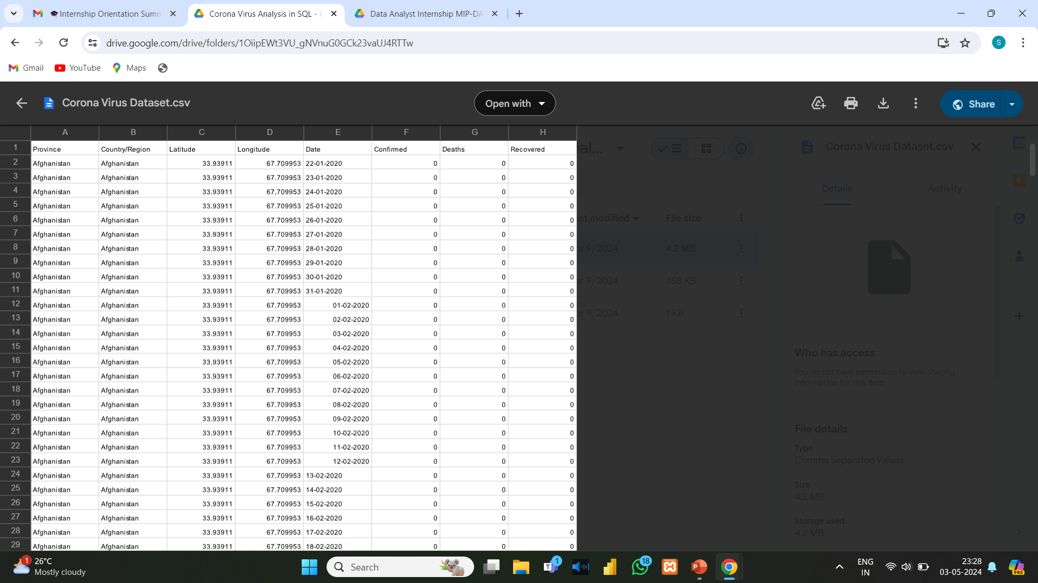
corona virus analysis database

Slide 5

TOOL USED FOR ANALYSIS
Microsoft SQL Server Management studio
SQL Server Management Studio (SSMS) is an integrated environment for managing any SQL infrastructure. Use SSMS to access, configure, manage, administer, and develop all components of SQL Server, Azure SQL Database, Azure , SQL Server on Azure VM.

Slide 6
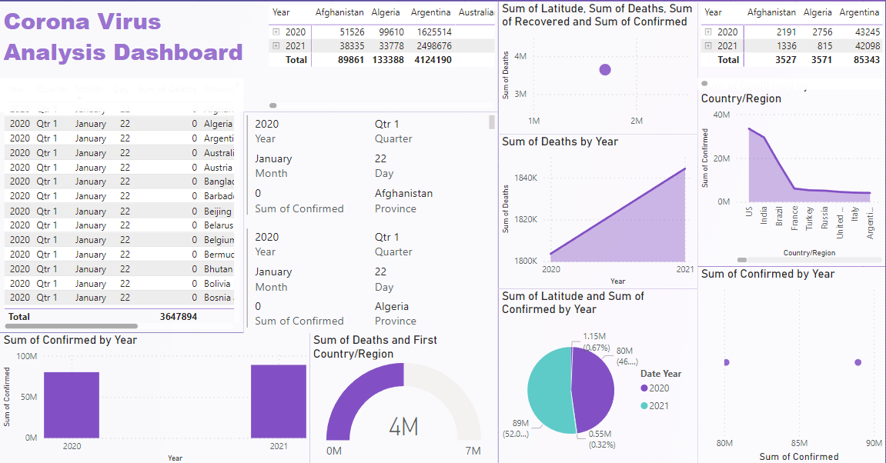

Slide 7

Key questions :
Write a code to check NULL values
If NULL values are present, update them with zeros for all columns.
check total number of rows
Check what is start_date and end_date .
Number of month present in dataset
Find monthly average for confirmed, deaths, recovered
Find most frequent value for confirmed, deaths, recovered each month
Find minimum values for confirmed, deaths, recovered per year
Find maximum values of confirmed, deaths, recovered per year
The total number of case of confirmed, deaths, recovered each month
Check how corona virus spread out with respect to confirmed case.
(Eg.: total confirmed cases, their average, variance & STDEV )
12. Check how corona virus spread out with respect to death case per month
(Eg.: total confirmed cases, their average, variance & STDEV )
Q13. Check how corona virus spread out with respect to recovered case
(Eg.: total confirmed cases, their average, variance & STDEV )
14. Find Country having highest number of the Confirmed case.
15. Find Country having lowest number of the death case
16. Find top 5 countries having highest recovered case

Slide 8
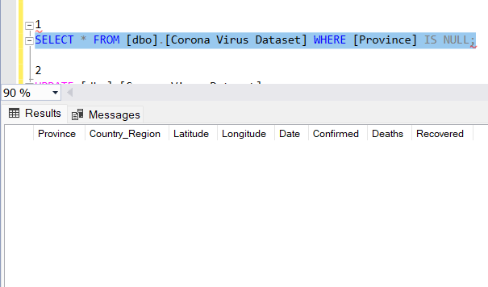
Corona Virus Analysis
1. Write code to check null values.
SELECT * FROM [dbo].[Corona Virus Dataset] WHERE [Province] IS NULL;
> There are no null values in given database

Slide 9
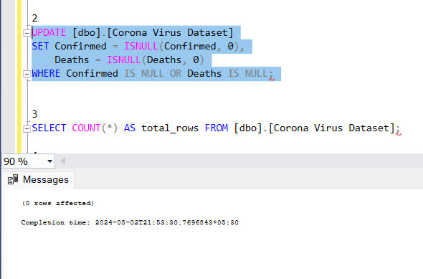
2. If null values are present, update them to zeros for all columns
UPDATE [dbo].[Corona Virus Dataset]
SET Confirmed = ISNULL(Confirmed, 0),
Deaths = ISNULL(Deaths, 0)
WHERE Confirmed IS NULL OR Deaths IS NULL;
> There are no null values in given database

Slide 10
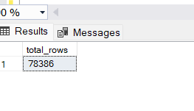
3. Check total number of rows.
SELECT COUNT(*) AS total_rows FROM [dbo].[Corona Virus Dataset];

Slide 11
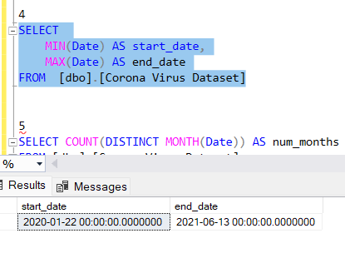
4.Check what is start_date and end_date.
SELECT
MIN(Date) AS start_date,
MAX(Date) AS end_date
FROM [dbo].[Corona Virus Dataset]

Slide 12
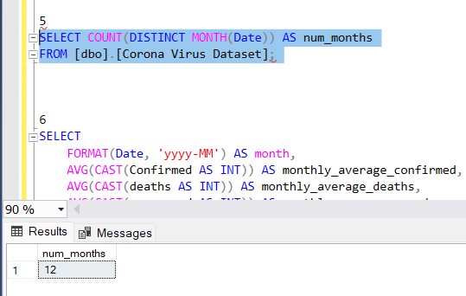
5.Number of month present in dataset.
SELECT COUNT(DISTINCT MONTH(Date)) AS num_months
FROM [dbo].[Corona Virus Dataset];

Slide 13
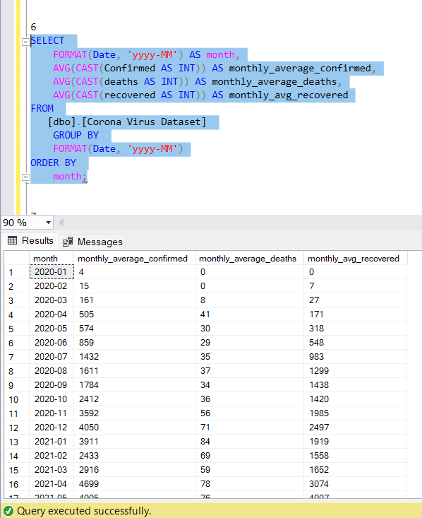
6. Find monthly average for confirmed,deaths,recovered.
SELECT
FORMAT(Date, 'yyyy-MM') AS month,
AVG(CAST(Confirmed AS INT)) AS monthly_average_confirmed,
AVG(CAST(deaths AS INT)) AS monthly_average_deaths,
AVG(CAST(recovered AS INT)) AS monthly_avg_recovered
FROM
[dbo].[Corona Virus Dataset]
GROUP BY
FORMAT(Date, 'yyyy-MM')
ORDER BY
month;

Slide 14
7. Find most frequent value for confirmed,deaths,recovered each month.
WITH MonthlyCounts AS (
SELECT
YEAR(Date) AS year,
MONTH(Date) AS month,
confirmed,
deaths,
recovered,
ROW_NUMBER() OVER (PARTITION BY YEAR(Date), MONTH(Date), confirmed, deaths, recovered ORDER BY COUNT(*) DESC) AS rn
FROM [dbo].[Corona Virus Dataset]
GROUP BY YEAR(Date), MONTH(Date), confirmed, deaths, recovered
)
SELECT
year,
month,
confirmed,
deaths,
recovered
FROM MonthlyCounts
WHERE rn = 1;

Slide 15
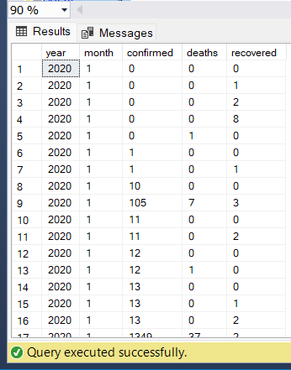
output 7

Slide 16
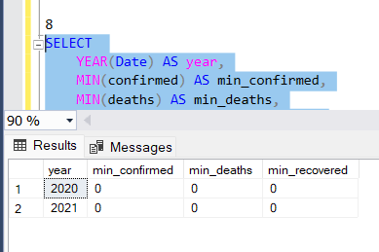
8.Find minimum values for confirmed,deaths,recovered per month.
SELECT
YEAR(Date) AS year,
MIN(confirmed) AS min_confirmed,
MIN(deaths) AS min_deaths,
MIN(recovered) AS min_recovered
FROM
[dbo].[Corona Virus Dataset]
GROUP BY
YEAR(Date)
ORDER BY
YEAR(Date) ASC;

Slide 17
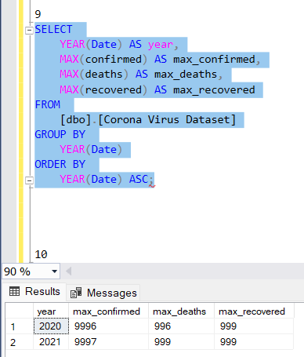
9.Find maximum values of confirmed,deaths,recovered per year.
SELECT
YEAR(Date) AS year,
MAX(confirmed) AS max_confirmed,
MAX(deaths) AS max_deaths,
MAX(recovered) AS max_recovered
FROM
[dbo].[Corona Virus Dataset]
GROUP BY
YEAR(Date)
ORDER BY
YEAR(Date) ASC;

Slide 18
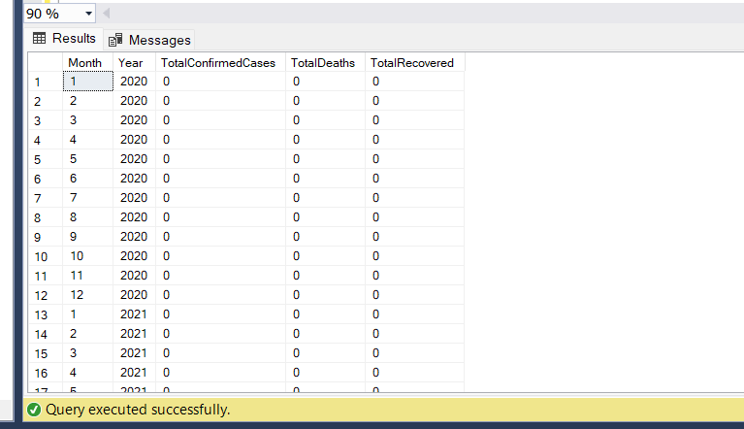
10.The total number of case of confirmed,deaths,recovered each month.
SELECT
MONTH(Date) AS Month,
YEAR(Date) AS Year,
SUM(CASE WHEN Confirmed = 'Confirmed' THEN 1 ELSE 0 END) AS TotalConfirmedCases,
SUM(CASE WHEN Deaths = 'Deaths' THEN 1 ELSE 0 END) AS TotalDeaths,
SUM(CASE WHEN Recovered = 'Recovered' THEN 1 ELSE 0 END) AS TotalRecovered
FROM [dbo].[Corona Virus Dataset]
GROUP BY YEAR(Date), MONTH(Date)
ORDER BY YEAR(Date), MONTH(Date);

Slide 19
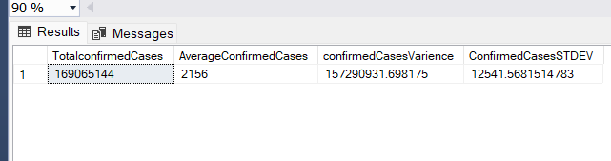
11.Check how corona virus spread out with respect to confirmed case
(Eg.: total confirmed cases, their average, variance & STDEV ).
SELECT
SUM(CAST(Confirmed AS INT)) AS TotalconfirmedCases,
AVG(CAST(Confirmed AS INT)) AS AverageConfirmedCases,
VAR(CAST(Confirmed AS INT)) AS confirmedCasesVarience,
STDEV(CAST(Confirmed AS INT)) AS ConfirmedCasesSTDEV
FROM [dbo].[Corona Virus Dataset]

Slide 20
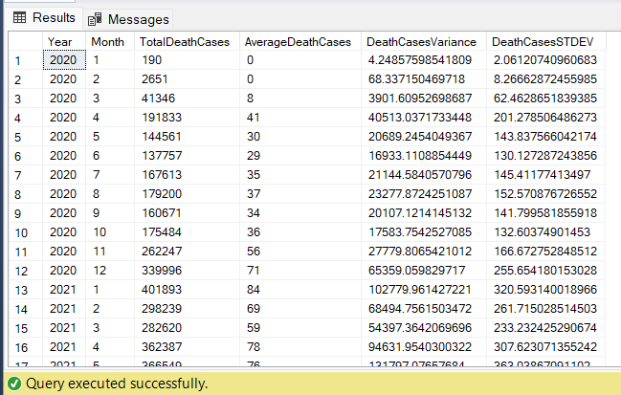
12. Check how corona virus spread out with respect to death case per month
(Eg.: total confirmed cases, their average, variance & STDEV ).
SELECT
YEAR(Date) AS Year,
MONTH(Date) AS Month,
SUM(CAST(Deaths AS INT)) AS TotalDeathCases,
AVG(CAST(Deaths AS INT)) AS AverageDeathCases,
VAR( CAST(Deaths AS INT)) AS DeathCasesVariance,
STDEV(CAST(Deaths AS INT)) AS DeathCasesSTDEV
FROM [dbo].[Corona Virus Dataset]
GROUP BY YEAR(Date), MONTH(Date)
ORDER BY Year, Month;

Slide 21
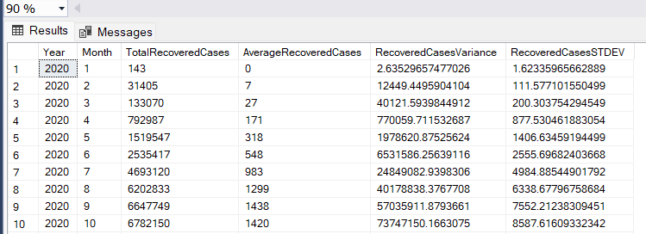
13 Check how corona virus spread out with respect to recovered case
(Eg.: total confirmed cases, their average, variance & STDEV ).
SELECT
YEAR(Date) AS Year,
MONTH(Date) AS Month,
SUM(CAST(Recovered AS INT)) AS TotalRecoveredCases,
AVG(CAST(Recovered AS INT)) AS AverageRecoveredCases,
VAR( CAST(Recovered AS INT)) AS RecoveredCasesVariance,
STDEV(CAST(Recovered AS INT)) AS RecoveredCasesSTDEV
FROM [dbo].[Corona Virus Dataset]
GROUP BY YEAR(Date), MONTH(Date)
ORDER BY Year, Month;

Slide 22
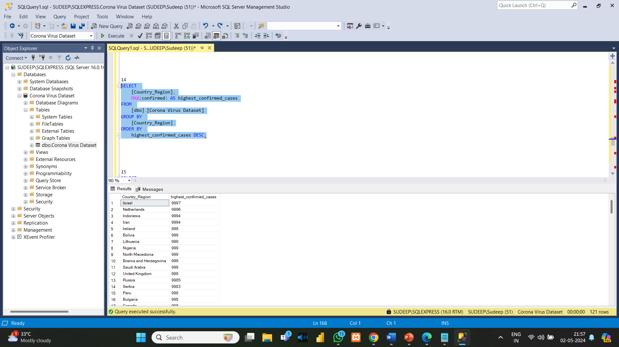
14. Find Country having highest number of the Confirmed case.
SELECT
[Country_Region],
MAX(confirmed) AS highest_confirmed_cases
FROM
[dbo].[Corona Virus Dataset]
GROUP BY
[Country_Region]
ORDER BY
highest_confirmed_cases DESC;

Slide 23
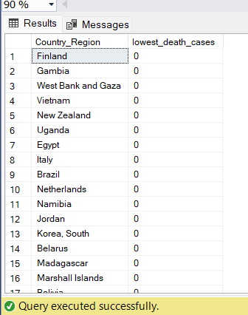
15.Find the country having lowest number of death cases.
SELECT
[Country_Region],
MIN(deaths) AS lowest_death_cases
FROM
[dbo].[Corona Virus Dataset]
GROUP BY
[Country_Region]
ORDER BY
lowest_death_cases ASC;

Slide 24
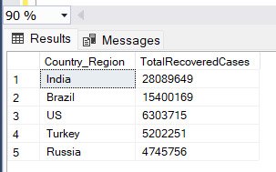
16. Find the top 5 countries having highest recovered case.
SELECT TOP 5 Country_Region, SUM(CAST(Recovered AS INT)) AS TotalRecoveredCases
FROM [dbo].[Corona Virus Dataset]
GROUP BY Country_Region
ORDER BY TotalRecoveredCases DESC

Slide 25


Thank you
.

